Slide 1
Midterm project
Chenxi Xu

Slide 2
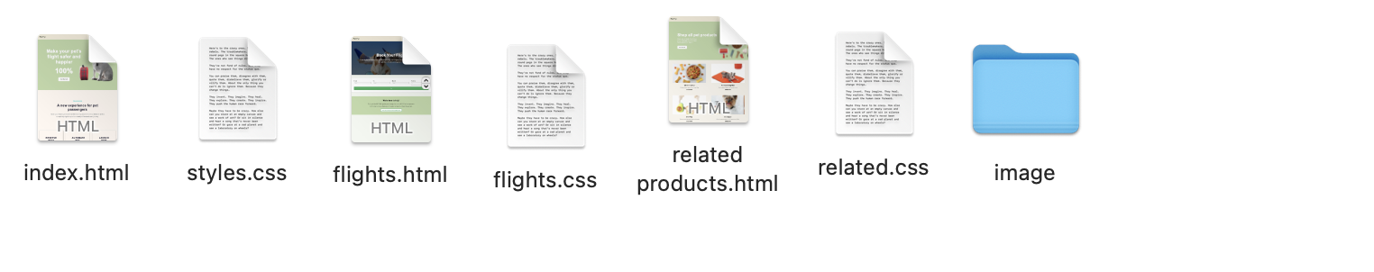
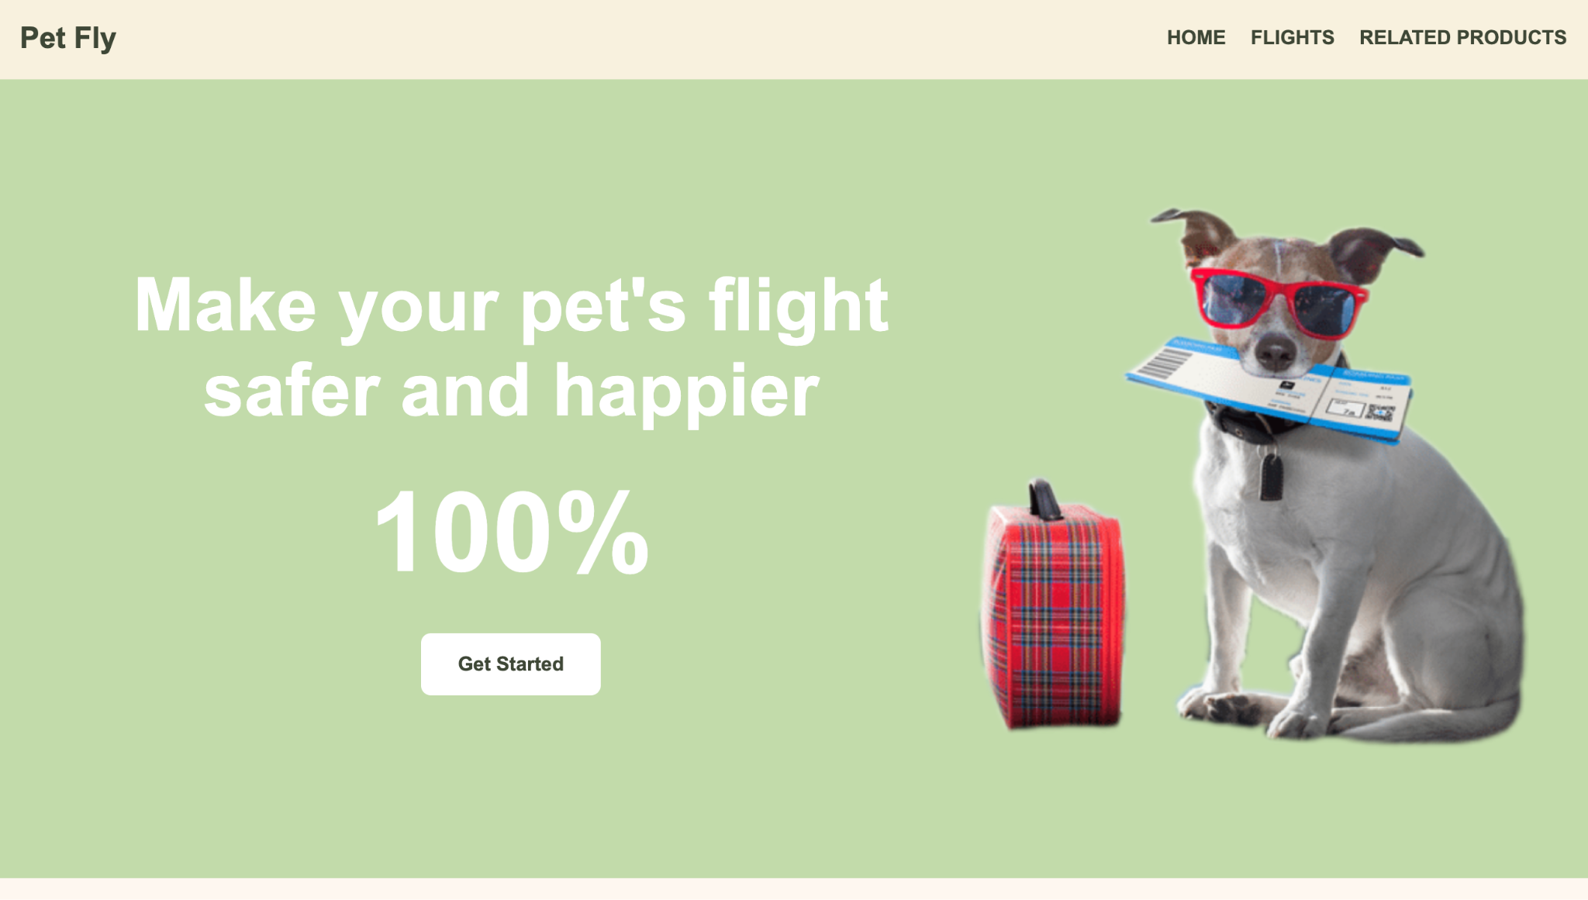

Slide 3
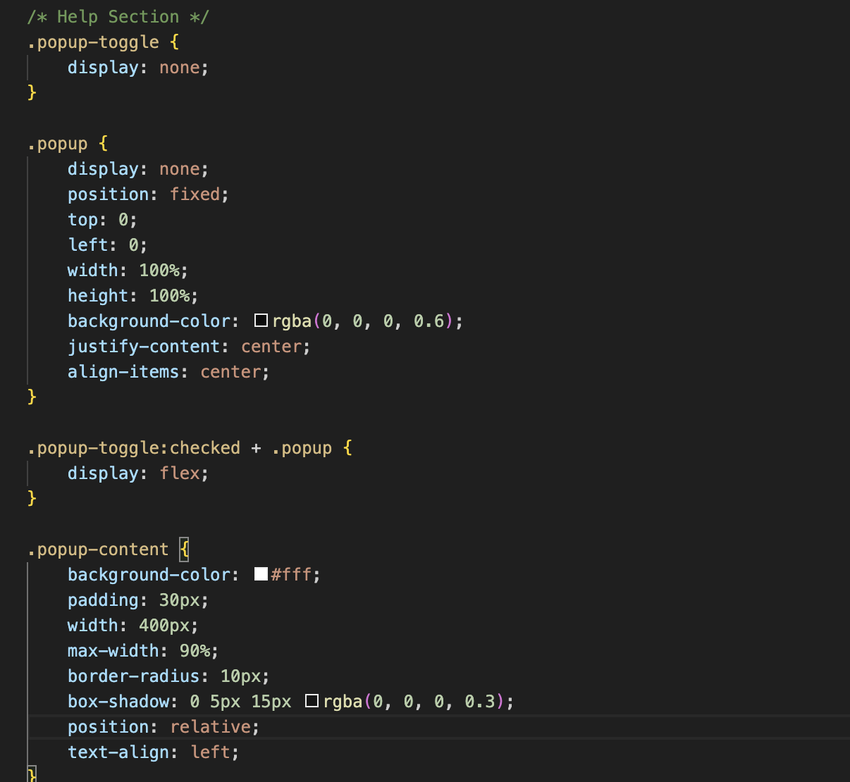
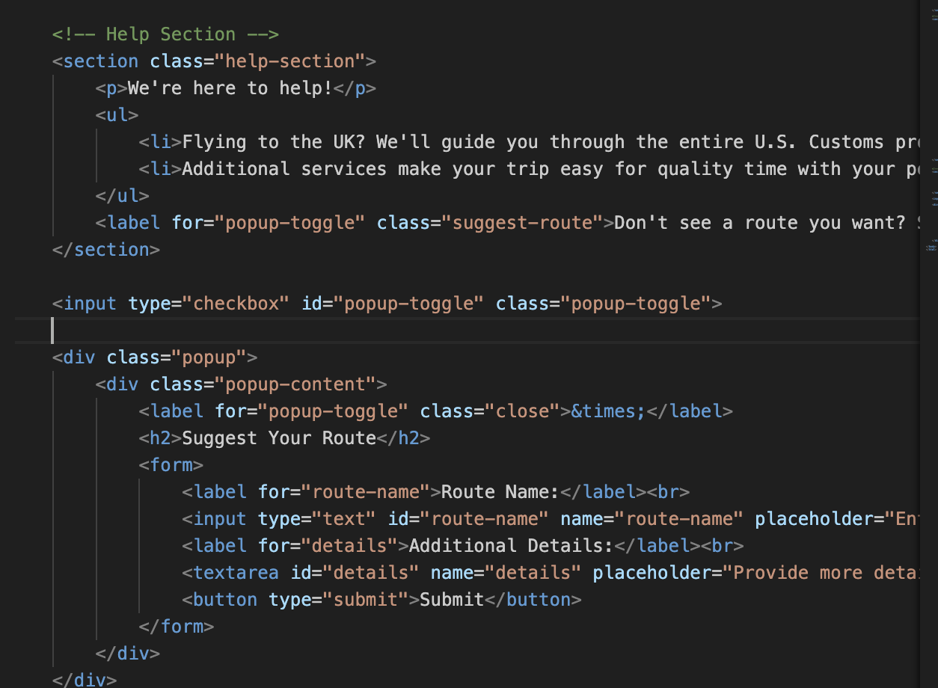
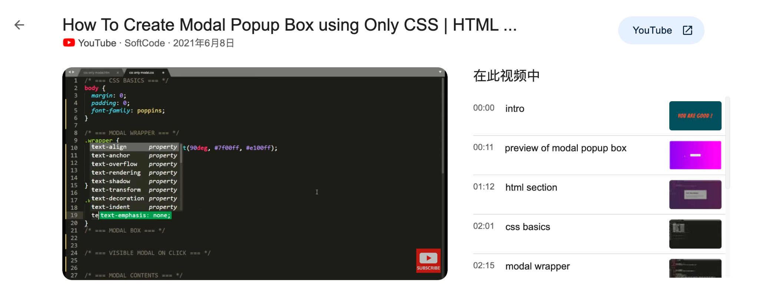
tutorial

Slide 4
I will add more dynamic effects.
I want to add a pagination feature.
I will include more information.
I plan to change the appearance of the cursor.

Slide 5
Thank you!!!

